Slide 1
Dialysis Facility Compare
Valarie Ashby
Co-Managing Director
UM-KECC

Slide 2
Background
ESRD is when the kidneys stop working well enough for you to live without dialysis or a transplant. This kind of kidney failure is permanent. It cannot be fixed. Most cases of ESRD are caused by diabetes or high blood pressure.
Dialysis is the artificial process of eliminating waste (diffusion) and unwanted water (ultrafiltration) from the blood. Our kidneys do this naturally. Some people, however, may have failed or damaged kidneys which cannot carry out the function properly - they may need dialysis.
There are two main types of dialysis - hemodialysis (HD) and peritoneal dialysis (PD). Hemodialysis is performed in a center or at home (HHD)
Traditional in-center hemodialysis is performed in a dialysis center by trained health care professionals three days a week, usually for about four hours per treatment.
Patients who choose HHD or PD, which are both performed at home, will still visit a dialysis center, usually once a month, to check in with your dialysis care team.

Slide 3
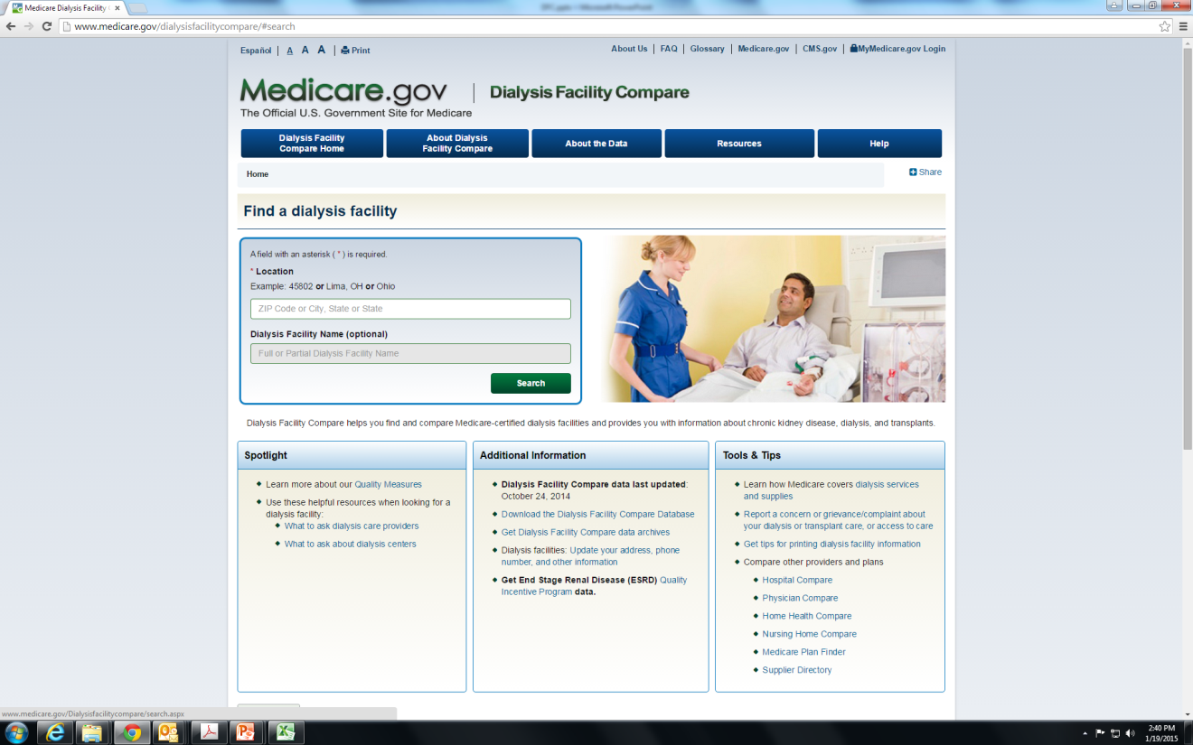
Dialysis Facility Compare Website
The Dialysis Facility Compare (DFC) website is a service of the Centers for Medicare & Medicaid Services (CMS) that has become a major information resource for patients with end stage renal disease (ESRD) on finding detailed information on Medicare-certified dialysis facilities.
Data on 6,237 dialysis facilities are currently available to the public.
These data are based on over half a million dialysis patients.

Slide 4
DFC Dialysis Facility Characteristics and Services
Name address including state and zip code
Shifts after 5 (Yes, No)
Types of dialysis (In-center HD, PD, Home HD)
Number of dialysis stations
Facility ownership type (Profit, Non-profit)
Facility dialysis organization or corporation name
Certification date (how long the facility has been open)

Slide 5
DFC Quality Measures
Standardized Measures
Standardized Hospitalization Ratio (SHR)
Standardized Mortality Ratio (SMR)
Standardized Transfusion Ratio (STrR)
Practice Patterns (Range 0-100%)
Percentage of adult hemodialysis (HD) patients who had enough wastes removed from their blood during dialysis
Percentage of pediatric hemodialysis (HD) patients who had enough wastes removed from their blood during dialysis
Percentage of adult peritoneal dialysis (PD) patients who had enough wastes removed from their blood during dialysis
Percentage of adult dialysis patients who had hypercalcemia
Percentage of adult dialysis patients who received treatment through arteriovenous fistula
Percentage of adult patients who had a catheter left in vein longer than 90 days for their regular hemodialysis treatment

Slide 6
Standardized Measures
Standardized Mortality Ratio (SMR) – a comparison of a facility’s actual number of patient deaths to the expected number based on patients’ characteristics. (lower is better)
Standardized Hospitalization Ratio (SHR) – a comparison of a facility’s actual number of hospital admissions among its Medicare dialysis patients to the expected number of hospital admissions based on patients’ characteristics. (lower is better)
Standardized Transfusion Ratio (STrR) –a comparison of the actual number of eligible transfusion events in adult Medicare patients dialyzing at the facility to the expected number of eligible red blood cell transfusion events based on patients’ characteristics. (lower is better)

Slide 7
Practice Pattern Measures
Percentage of adult hemodialysis (HD) patients who had enough wastes removed from their blood during dialysis – the percentage of adult hemodialysis patients getting regular dialysis treatments at the facility whose average Kt/V for the month was 1.2 or higher (higher percentage is better)
Percentage of pediatric hemodialysis (HD) patients who had enough wastes removed from their blood during dialysis – the percentage of children (under 18) getting regular dialysis treatments at the facility whose average Kt/V for the month was 1.2 or higher (higher percentage is better)
Percentage of adult peritoneal dialysis (PD) patients who had enough wastes removed from their blood during dialysis – the percentage of adult peritoneal dialysis patients getting regular dialysis treatments at the facility whose Kt/V for the month was 1.7 or higher (higher percentage is better)
Percentage of adult dialysis patients who received treatment through arteriovenous (AV) fistula – the percentage of adult patients getting regular hemodialysis at the facility who had an AV fistula for receiving dialysis treatment (higher percentage is better)
Percentage of adult patients who had a catheter left in vein longer than 90 days for their regular hemodialysis treatment – the percentage of adult HD patients being treated at the facility who had a catheter (tube) inserted into a vein for hemodialysis treatment that was left in place for more than 90 days (lower percentage is better)
Percentage of adult dialysis patients who had hypercalcemia (too much calcium in blood) – the percentage of adult HD and PD patients being treated at the facility whose average calcium was greater than 10.2 mg/dL (lower percentage is better)

Slide 8
Research Question
What is the relationship between hospitalization (SHR) and other quality measures and facility characteristics?

