Slide 1
Two Decades of Stroke Disparities Research – What have we learned and where are we going?
Lynda Lisabeth, PhD

Slide 2
My Journey
BS in statistics
MPH in biostatistics
Several years of work experience
Phd in epidemiology
  Interest in health equity, chronic disease, methods
Research faculty in Neurology
Tenure track faculty in Epidemiology

Slide 3
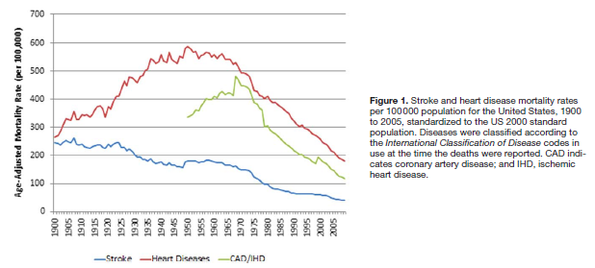
What is stroke?
Artery in brain is clogged or ruptures
Ischemic strokes account for ~83% of all strokes
5th leading cause of death in US
#1 cause of adult disability**
Notes:
Notes as one of the top 10 great public health acheivements

Slide 4

Michigan Stroke program
Stroke health disparities**
Stroke behavioral and educational interventions
Sleep apnea and stroke research*
Health services research
Clinical trials
Basic science research

Slide 5
Outline
Brain Attack Surveillance in Corpus Christi Project or BASIC
  Background/beginnings
  Methods
  Evolution/major findings
  Other contributions
  Spin-off projects
  Newest directions

Slide 6
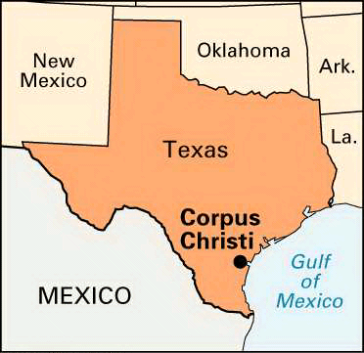
BASIC – The Beginning
Previous work in Corpus Christi focused on heart disease
Demonstrated greater heart disease burden in MAs
Heart disease and stroke share common risk factors
Little known about stroke in MAs
Need for basic epidemiologic information on stroke burden in MAs
  How to acquire?

Slide 7
Population-based stroke surveillance
Collect ALL strokes for a defined population
  Capture cases from all sources – hospitals, out of hospital sources, deaths
  Use Census data to characterize population at-risk
  Requires intense interaction and partnership with community**

Slide 8
Why Corpus Christi?
Data availability
  Research infrastructure - ability to collect strokes
  Census data - ability to enumerate MA population
Population size - ~300,000
  Non-immigrant MA population
  ~60% MA/35% NHW
Geographically isolated from other major cities

Slide 9
BASIC Project
Funded in 2000
Purpose:
  Population-based stroke surveillance
  Establish public health impact of stroke in MAs
    Incidence, mortality, recurrence, risk factors

Slide 10
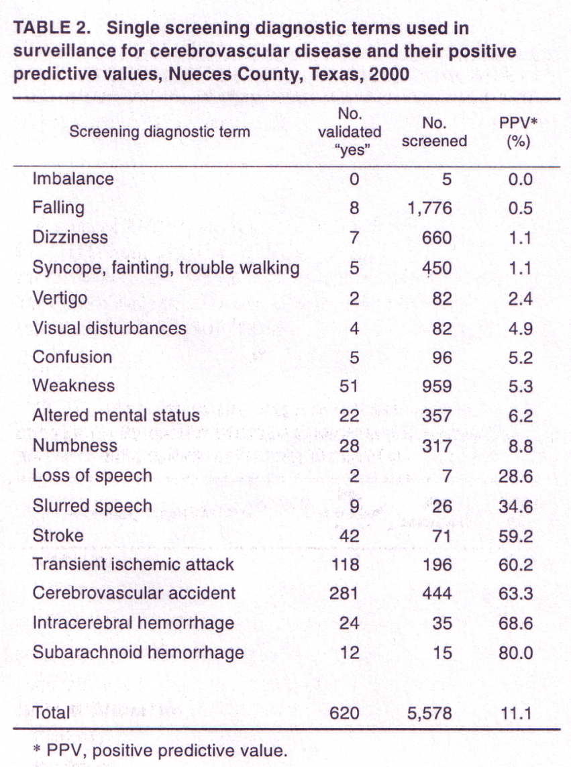
Surveillance Methods
7 hospitals, 11 neurologists
Active surveillance
  Screening of admission records, emergency department logs, ICUs
  Random sample of PCPs, neurologists, nursing homes
Passive surveillance
  Searching hospital discharge diagnoses

Slide 11
Stroke Validation/Definitions
Clinical stroke definition - focal neurologic symptoms lasting >24 hours
  Neuroimaging not required**
Neurologists blinded to ethnicity and age
yes
Validation
by
Neurologists
yes
Screening/
verification
Stroke Pool
no
no
Stop
67,177 screened
10,456 strokes
6,861 interviewed
Stop

Slide 12
Early Results

Slide 13
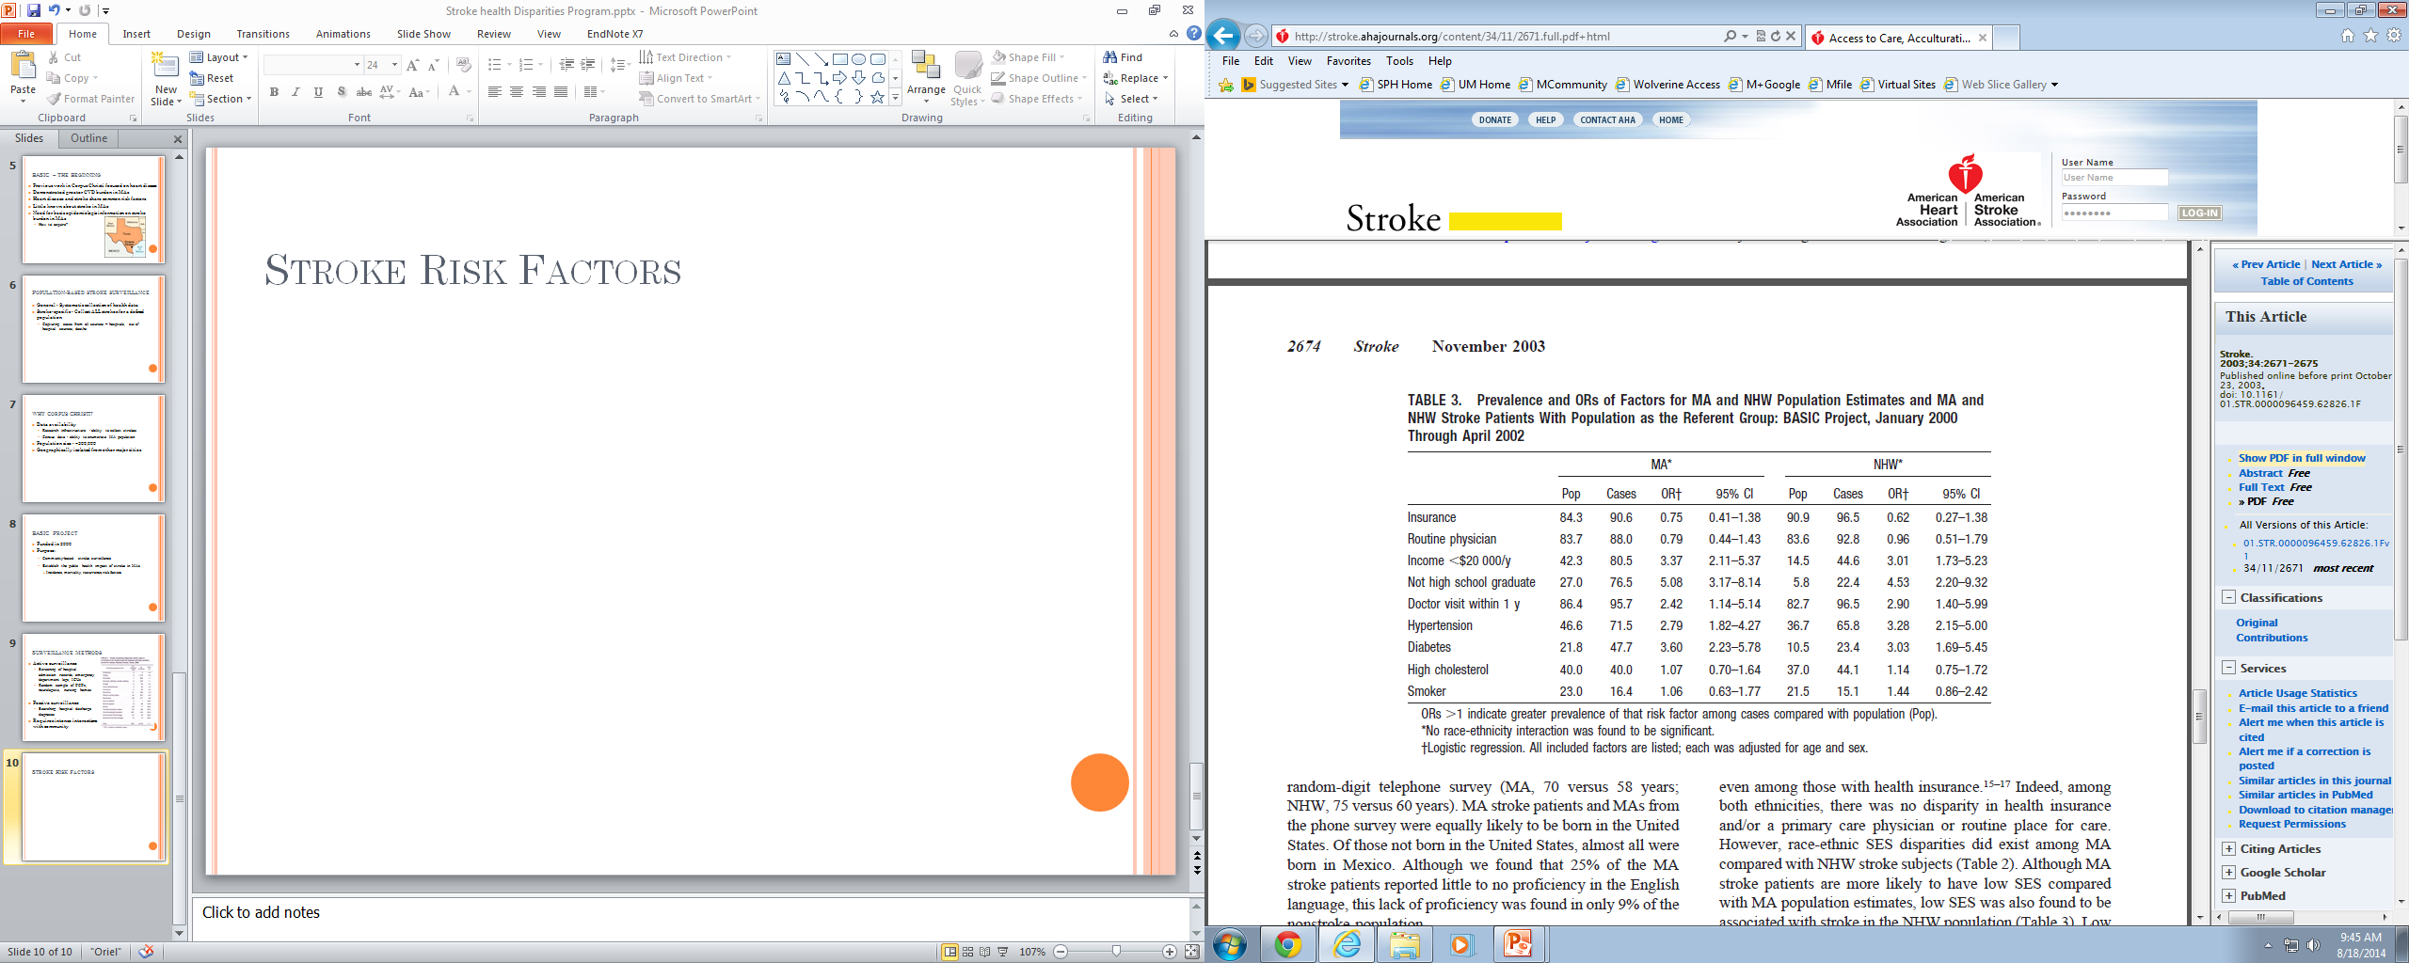
Stroke Risk Factors
Smith et al. Stroke 2003;34:2671-2675

Slide 14
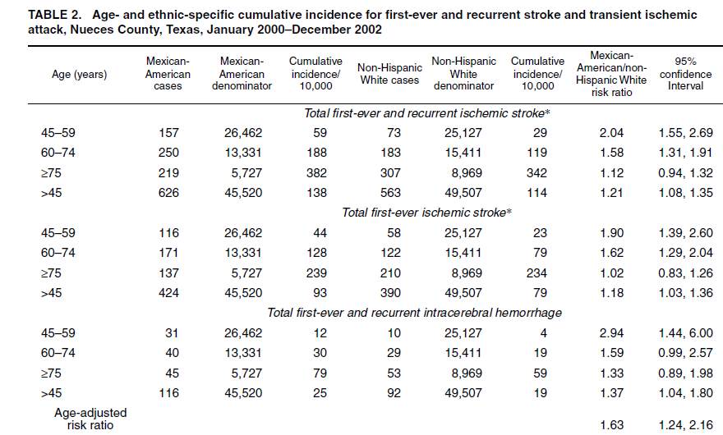
Stroke Incidence
Morgenstern et al. AJE 2004;160:376-383

Slide 15

Post-Stroke Mortality
Lisabeth et al. Annals of Epidemiol 2006;16:33-40.

Slide 16
Summary and Next Steps
Summary
  Stroke risk factors more prevalent in MAs than NHWs but associations with stroke similar by ethnicity
  MAs greater stroke risk than NHWs particularly at younger ages (greater risk of recurrence)
  MAs lower post-stroke mortality than NHWs
Next steps
  Investigating better post-stroke survival
    Surviving with greater disability, protective socio-cultural factors
  Understanding trends
    Are we making progress towards reducing disparities?

Slide 17
BASIC 2 and 3
Funded in 2004 and 2009
Purpose:
  Continued population-based stroke surveillance
  Focus on the role of acculturation, acculturative stress, optimism, fatalism, spirituality, depression
  Investigate trends and stroke outcomes by ethnicity

Slide 18
Methodological Changes
2004/2005
  Updated interviews/medical record abstraction to capture socio-cultural factors and do not resuscitate orders
  Changes in surveillance – discontinued screening PCPs
2008/2009
  Interview everyone
  Added outcome interviews at 90 days post-stroke - neurologic, functional, cognitive outcomes
  Changes in surveillance – discontinued screening neurology offices

Slide 19
Unique Challenges to Stroke Research
Stroke is acute – patients/families unprepared
Patients are often very sick
Patients often can’t communicate
Changes in ability to consent over time
Stroke patients hard to locate
Patients lost to follow up are different
New definition of stroke**

Slide 20
Results continued

Slide 21

Socio-cultural Factors
Morgenstern et al. Stroke 2011;42:3518-3523

Slide 22
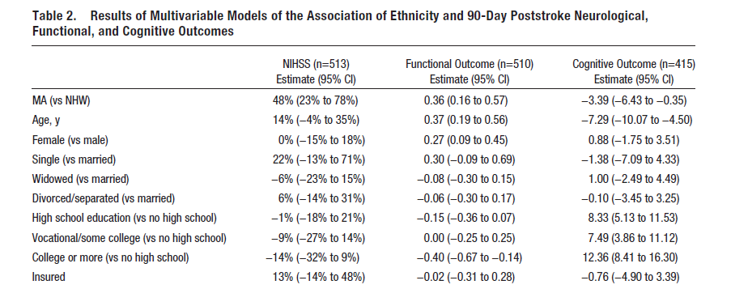
Stroke Outcomes
Lisabeth et al. Stroke 2014;45

Slide 23
Stroke Outcomes – impact of mortality
Interested in understanding extent to which ethnic differences are attributed to differences in mortality
Re-estimated outcome models using weights to account for differential post-stroke mortality by ethnicity
Ethnic differences in outcomes attenuated but remained significant

Slide 24
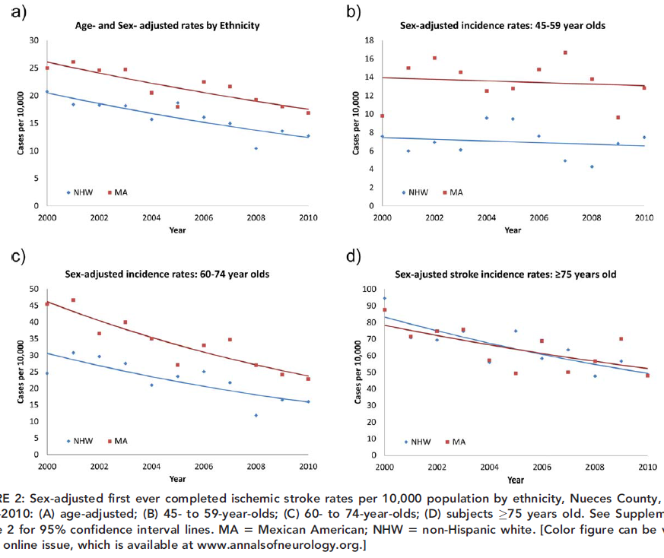
Stroke Incidence Trends
Morgenstern et al. Annals of Neurol 2013;74:778-785.

Slide 25
Impact of Changes in Surveillance

Slide 26
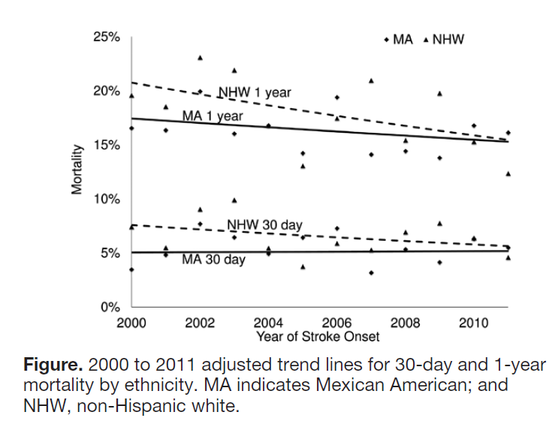
Post-Stroke Mortality Trends
Morgenstern et al. Stroke 2014;45.

Slide 27
Summary and Next Steps
Summary
  Incidence decreasing but ethnic disparities remain
  Worse stroke outcomes in MAs compared with NHWs – not fully explained by mortality
  MA survival advantage disappeared
Next steps
  Understanding trends
    Are we making progress towards reducing disparities?
  Investigating long-term outcomes
    Do disparities persist?
  Unmet needs and informal care in survivors
    Identification of potential interventions

Slide 28

BASIC 4
Funded in 2014
Purpose:
  Continued population-based stroke surveillance
  Evaluate impact of new stroke definition
  Investigate trends
  Investigate long-term stroke outcomes by ethnicity
  Describe informal caregiving networks and unmet needs among community dwelling stroke survivors

Slide 29
Methodological Changes
2014
  Changes in surveillance to capture strokes under new definition
    Reinstitute screening at neurology offices
    Discussions with outpatient radiology facilities
  Streamline baseline interview
  Added outcome interviews at 3, 6 and 12 months - neurologic, functional, cognitive outcomes

Slide 30
New Stroke Definition

Slide 31
Preliminary Results

Slide 32
Stroke Trends

Slide 33
Mortality

Slide 34
Longitudinal Outcomes

Slide 35
Summary and Next Steps
Summary
  New patterns emerging in stroke incidence
  Declines in mortality significant only in NHWs suggesting that, for the first time, mortality will be significantly greater in MAs
  Ethnic stroke outcome disparities emerge at 90 days and persist
Next steps
  Understanding trends
  Investigating patient reported outcomes
  New data linkages

Slide 36
BASIC 5
Funded in 2019
Purpose:
  Continued population-based stroke surveillance
  Investigate trends including stroke outcomes
  Investigate patient reported stroke outcomes by ethnicity
  Investigate patterns of interaction with the healthcare system in stroke patients

Slide 37
Methodological Changes
2019
  Dropping 6 and 12 month outcome interviews
  Adding patient reported outcomes to 3 month outcome interview
  Linking BASIC data with multiple administrative data sources (our “Big Data”)
    State inpatient data
    State emergency department data
    Medicare data

Slide 38
Data collection pending

Slide 39


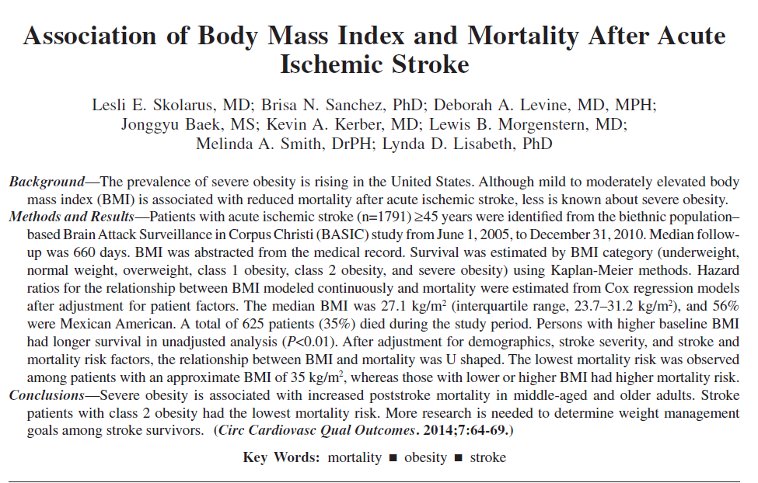
Other Contributions – Epidemiologic Observations

Slide 40

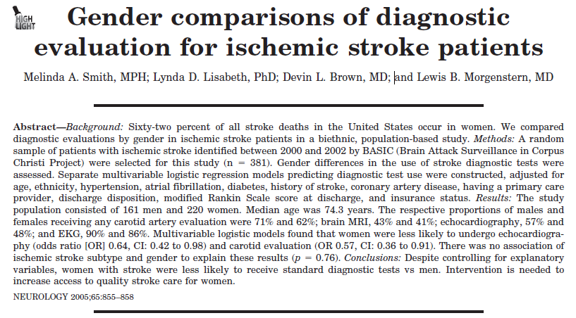
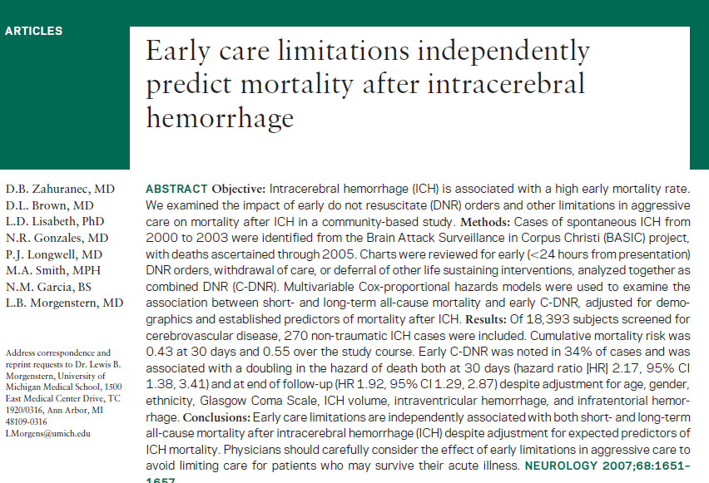
Other Contributions - Clinical Observations

Slide 41
BASIC Spin Off Projects

Slide 42
BASIC Sleep Study
Several grants funded
Purpose:
  To understand epidemiology of sleep apnea after stroke
  To investigate sleep apnea as a cause of greater stroke burden in MAs compared with NHWs

Slide 43
Background
Sleep apnea is common after stroke
Predicts incident stroke
Predicts poor stroke outcomes
Treatment effects unknown

Slide 44
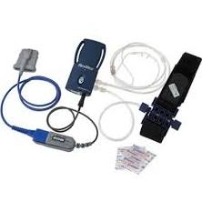
Methods
Sleep apnea assessments in stroke patients identified in BASIC within 30 days
ApneaLink PlusTM
  Validated portable cardiorespiratory monitor
  Raw data edited by registered polysomnographic technologist

Slide 45
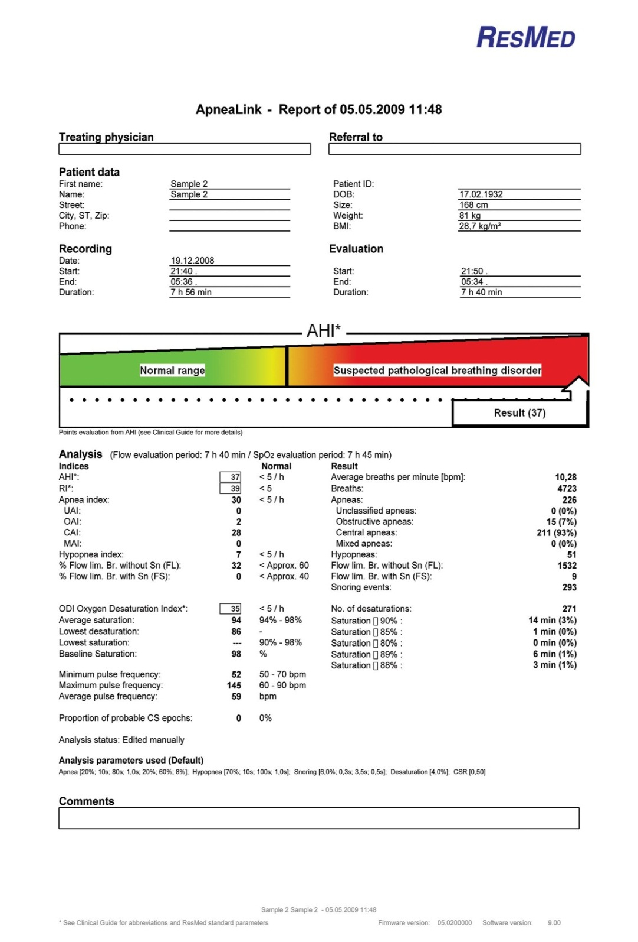


Slide 46
Results - Sleep

Slide 47
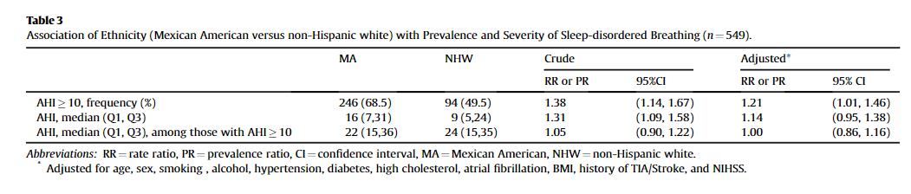
Post-stroke Sleep Apnea
Lisabeth et al. Sleep Medicine 2017;33:97-102.

Slide 48
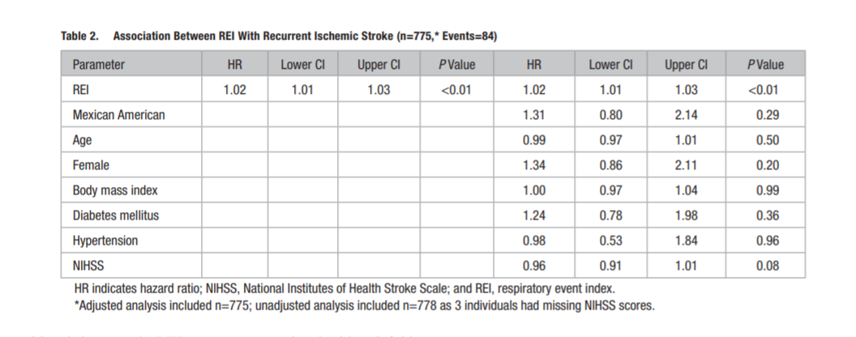
Sleep Apnea and Stroke Recurrence
Brown et al. Stroke 2019;50:571-576.

Slide 49
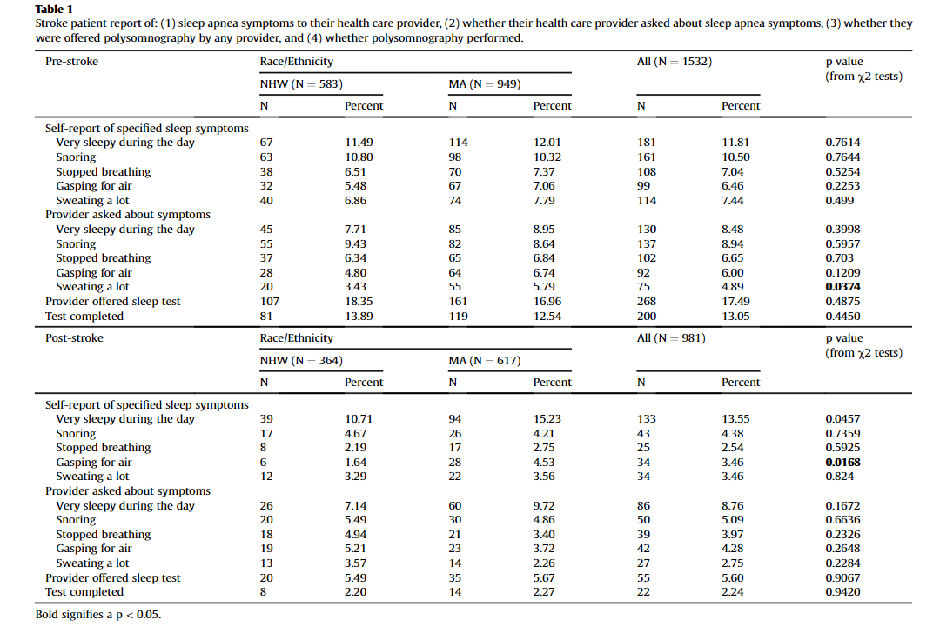
Sleep Apnea Screening After Stroke
Brown et al. Sleep Medicine 2019;59:94-95.

Slide 50
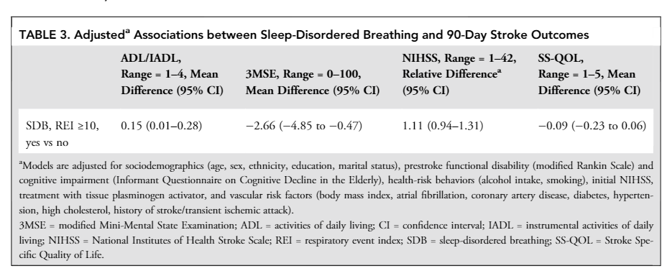
Sleep Apnea and Stroke Outcomes
Lisabeth et al. Annals of Neurology 2019; in press.

Slide 51
Summary
Summary
  Post-stroke sleep apnea is highly prevalent and more prevalent in MAs
  Post-stroke sleep apnea is associated with greater risk of recurrence and worse cognitive and functional outcome
  Screening for post-stroke sleep apnea is uncommon
Next steps
  Understanding longitudinal patterns of sleep apnea
    Identify which patients are likely to need reassessment, treatment adjustments, or long-term therapy

Slide 52
Nocturnal rostral fluid shifts and Sleep Apnea in Stroke Patients
Purpose:
  To assess for nocturnal rostral fluid shifts in hospitalized acute ischemic stroke patients and relate these fluid shifts to sleep apnea severity and stroke outcomes

Slide 53
Background
Sleep apnea common after stroke
Usual treatment (CPAP) poorly tolerated
Alternative treatments?
Why is it so common?
Daytime fluid pooling in legs may be redistributed
  Worse in stroke patients
Pharyngeal narrowing and increased airway collapsibility → worsen sleep apnea

Slide 54
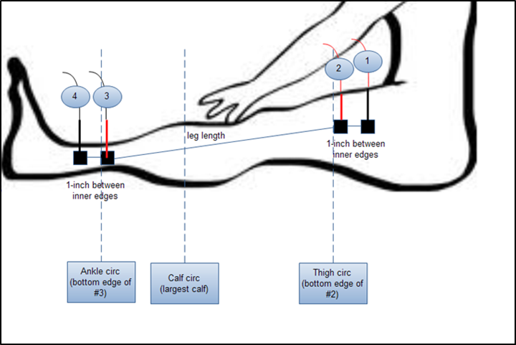
Measurements: before and after sleep
Calf circumference – decrease overnight
Neck circumference – increase overnight
Leg fluid volume – decrease overnight
  Bioimpedance

Slide 55
Clinical Implications
Potential for low cost, easily tolerated treatments
  Compression stockings
  Daytime physical activity
  Limitations to IV fluids
  Upward nocturnal tilting

Slide 56
Results pending

Slide 57
BASIC Post-Acute Care
New grant funded May 2019
Purpose:
  To investigate post-acute care following stroke in Mexican Americans and non-Hispanic whites including rehabilitation, informal caregiving, and gaps between caregiving needs and available community resources

Slide 58
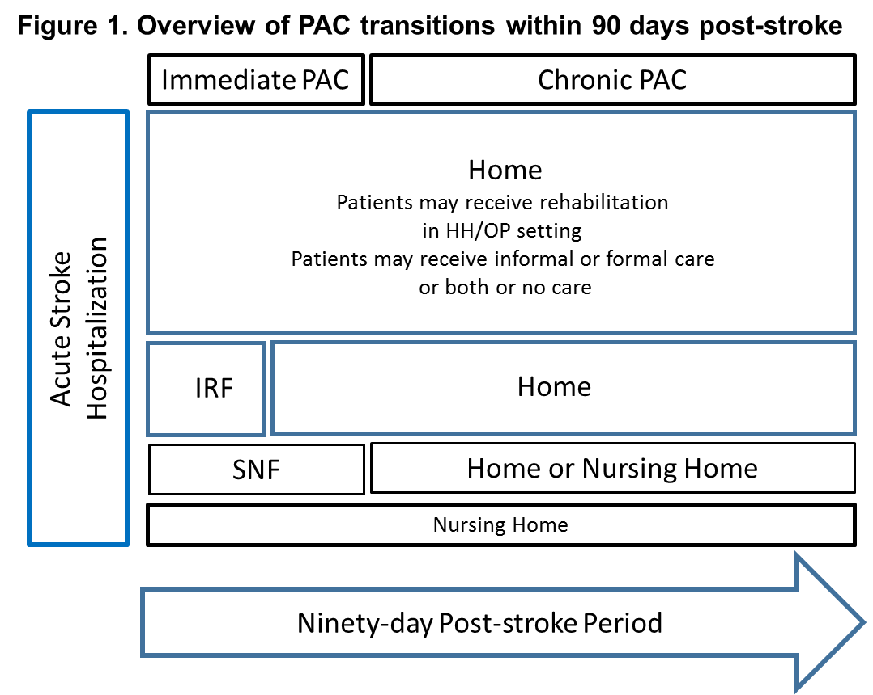
Background

Slide 59
Background
MAs worse stroke outcomes
Little data available on post-acute stroke care in MAs
  Prelim data suggest MAs less likely to receive more intense rehabilitation as inpatients and more likely to receive informal care in their home
Framework:
  PAC is optimized economically and socio-culturally if patients get early, intensive rehabilitation in the immediate PAC period followed by adequately resourced informal care at home

Slide 60
Methods
Assess PAC transitions over the 90-day period
Add questions to baseline interview on factors that might influence rehabilitation setting
Interview informal caregivers about their caregiving, needs and health outcomes
Identify community resources for stroke recovery and caregiving

Slide 61
Data collection pending

Slide 62
Overall Summary
Research is exciting and always evolving
Multidisciplinary research is critical
Methods matter
High quality training

Slide 63







Thank you
Thank you to the physicians, nurses, administrators, patients and families that have made BASIC possible!

Slide 64


