Slide 1
From Genomics to Prevention of Cardiovascular diseases
Ida Surakka
PostDoctoral Fellow
Department of Internal Medicine
Division of Cardiovascular Medicine
University of Michigan

Slide 2
Outline
Background for complex diseases
Genome-wide association analyses
Coronary heart disease prediction
Challenges in genetic prediction
Where to go from here?

Slide 3
Outline
Background for complex diseases
Genome-wide association analyses
Coronary heart disease prediction
Challenges in genetic prediction
Where to go from here?

Slide 4
Inheritance
Dad’s chromosomes
Mother’s chromosomes
Meiosis
Child’s chromosomes

Slide 5
Inheritance
Dad’s chromosomes
Mother’s chromosomes
Meiosis
Child’s chromosomes

Slide 6
Inheritance
Dad’s chromosomes
Mother’s chromosomes
Meiosis
Child’s chromosomes

Slide 7
Inheritance
Dad’s chromosomes
Mother’s chromosomes
Meiosis
Child’s chromosomes

Slide 8
Mutations
A T T G C A G C A G T C A A A G C T A G A T C A G C T A C A G C T

Slide 9
Mutations
A T T G C A G C A G T C A A A G C T A G A T C A G C T A C A G C T

Slide 10
Mutations
A T T G C A G C A G T C A A A G C T A G A T C A G C T A C A G C T
A T T G C A G C A G T C A A A G C T T G A T C A G C T A C A G C T
Single nucleotide polymorphism (SNP)

Slide 11
Mutations
A T T G C A G C A G T C A A A G C T A G A T C A G C T A C A G C T
A T T G C A G C A G T C A A A G C T T G A T C A G C T A C A G C T
SNP

Slide 12
Mutations
A T T G C A G C A G T C A A A G C T A G A T C A G C T A C A G C T
A T T G C A G C A G T C A A A G C T T G A T C A G C T A C A G C T
SNP
A T T G C A G A G T C A A A G C T T G A T C A G C T A C A G C T
Deletion

Slide 13
Mutations
A T T G C A G C A G T C A A A G C T A G A T C A G C T A C A G C T
A T T G C A G C A G T C A A A G C T T G A T C A G C T A C A G C T
SNP
A T T G C A G A G T C A A A G C T T G A T C A G C T A C A G C T
Deletion

Slide 14
Mutations
A T T G C A G C A G T C A A A G C T A G A T C A G C T A C A G C T
A T T G C A G C A G T C A A A G C T T G A T C A G C T A C A G C T
SNP
A T T G C A G A G T C A A A G C T T G A T C A G C T A C A G C T
Deletion
A T T G C A G A G T C A A A G C T T G A T C A G A C T A C A G C T
Insertion

Slide 15
Genetic Terminology
A mutation that doesn’t cause fatal phenotype and gets common in the population is called polymorphism or genetic variant
At each genetic locus (location in the genome) every individual has two alleles (versions), one from mother and one from father
By alleles we usually refer to alternate versions of polymorphism or mutation (can also refer to gene copy)
  A/T (SNP, individual has inherited two different alleles)
  T/T (SNP, individual has inherited same allele)
  -/T (individual has inherited deletion from one of the parent)
  ATG/G (individual has inherited insertion from one of the parents)

Slide 16
Monogenic vs Polygenic Disease
Single mutation in single gene
Multiple mutations in multiple genes
Gene C
Gene D
Gene A
Gene B
Gene E
Mendelian inheritance
Complex inheritance
Variant impact
Variant impact
100%
14%
8%
7%
11%
Phenotype severity depends on the genetic burden, ie. how many contributing variants patient carries
Phenotype usually severe and similar between carriers

Slide 17
Complex Disease
Risk burden:
40%
Multiple mutations in multiple genes
Gene C
Gene D
Gene B
Gene E

Slide 18
Complex Disease
Risk burden:
40%
Multiple mutations in multiple genes
Gene C
Gene D
Gene B
Gene E
Unhealthy lifestyle
Risk burden:
50%

Slide 19
Complex Disease
Risk burden:
40%
Multiple mutations in multiple genes
Gene C
Gene D
Gene B
Gene E
Risk burden:
90%
Unhealthy lifestyle
Risk burden:
50%

Slide 20
Well-known Examples
Heart diseases
Type 2 diabetes
Alzheimer’s disease
Dementia
Crohn’s disease &
Inflammatory bowel disease
Cancers

Slide 21
Why Study Complex Diseases?
Most impact on population health
  #1 killer in the world = cardiovascular diseases
  #2 killer in the world = cancers
Most impact on health care costs
  Effective prevention would save billions of dollars
General knowledge of the risk factors still scarce
  Prediction being dependent on the available information is still fairly inaccurate
Complex diseases are hard to study!

Slide 22
Outline
Background for complex diseases
Genome-wide association analyses
Coronary heart disease prediction
Challenges in genetic prediction
Where to go from here?

Slide 23
Genome-wide Association Study
Thousands (or millions) of genetic variants measured in thousands of samples
  Data matrix with thousands or rows and thousands/millions columns
  -> Seriously big data!!
Linear or logistic regression model applied for every variant
As a result we have summary statistics for thousands/millions of statistical tests
Large sample sizes needed for adequate power because of multiple testing penalty
  currently used significance threshold is 5e-8
$$Disease or trait \sim Mutation+Age+Sex+other covariates$$

Slide 24
How to achieve sample sizes of hundreds of thousands needed for genome-wide association analysis with adequate power?

Slide 25
How to achieve sample sizes of hundreds of thousands needed for genome-wide association analysis with adequate power?
Two commonly used methods: Meta-analysis or Biobank sample collection

Slide 26
Consortia Revolution
Small studies join forces to increase sample size -> Consortium
  First ones were founded ~15 years ago
There is a Consortium for almost every major disease available
Some of the biggest Consortia today:
    Global Lipids Genetics Consortium (blood lipids)
      Currently 1.2 million samples
    CardioGramC4D (Coronary artery disease)
      Currently over 1 million samples
    GIANT (Anthropometric traits)
      Currently over 1 million samples
  All of the above consortiums have over 30 million genetic mutations analyzed in their latest effort!!

Slide 27
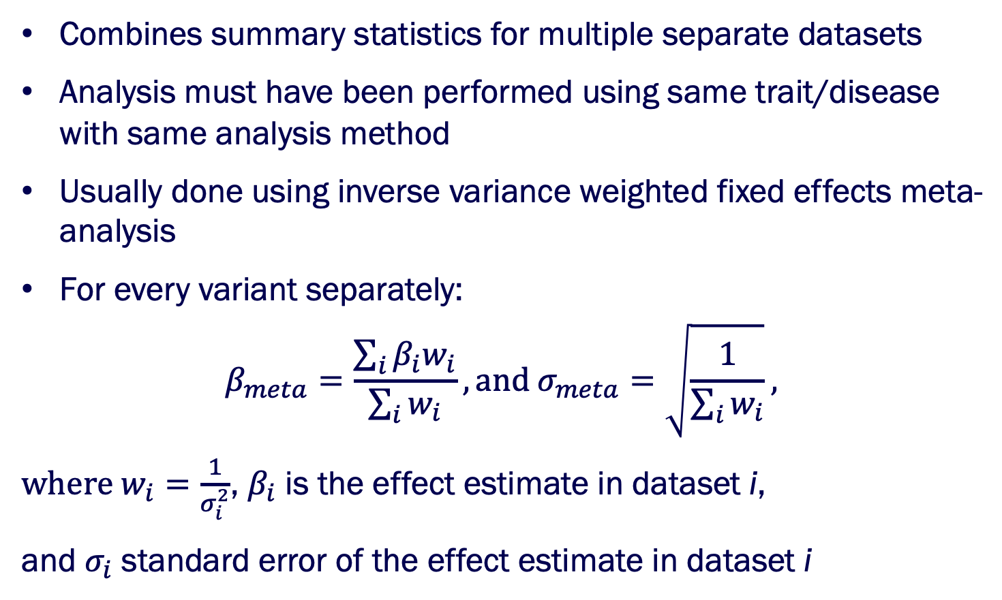
Meta-analysis
Combines summary statistics for multiple separate datasets
Analysis must have been performed using same trait/disease with same analysis method
Usually done using inverse variance weighted fixed effects meta-analysis
For every variant separately:
$$β_{meta}=\frac{\sum_{i}{β_{i}w_{i}}}{\sum_{i}{w_{i}}}, and σ_{meta}=\sqrt{\frac{1}{\sum_{i}{w_{i}}}},$$
$where w_{i}=\frac{1}{σ_{i}^{2}}$, $β_{i}$ is the effect estimate in dataset i,
and $σ_{i}$ standard error of the effect estimate in dataset i

Slide 28
Example: Blood lipids (8,800 samples, 18 loci)
Global lipids genetics consortium

Slide 29
Example: Blood lipids (100k samples, 95 loci)
Global lipids genetics consortium

Slide 30
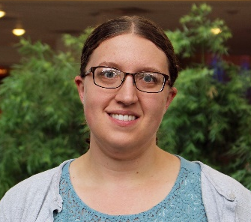
Example: Blood lipids (>1 million samples)
124
127
131
79
58
Sarah Graham
University of Michigan

Slide 31
Biobanks
The new wave in human genetics
Large collections of samples with DNA information, dense phenotyping and electronic health records available
Largest examples:
  UK-Biobank, 500,000 samples from United Kingdom
  Biobank Japan, 200,000 samples from Japan
  Million Veteran program, 300,000 United States Veterans
  FinnGen, 500,000 samples from Finland (sample collection ongoing)

Slide 32
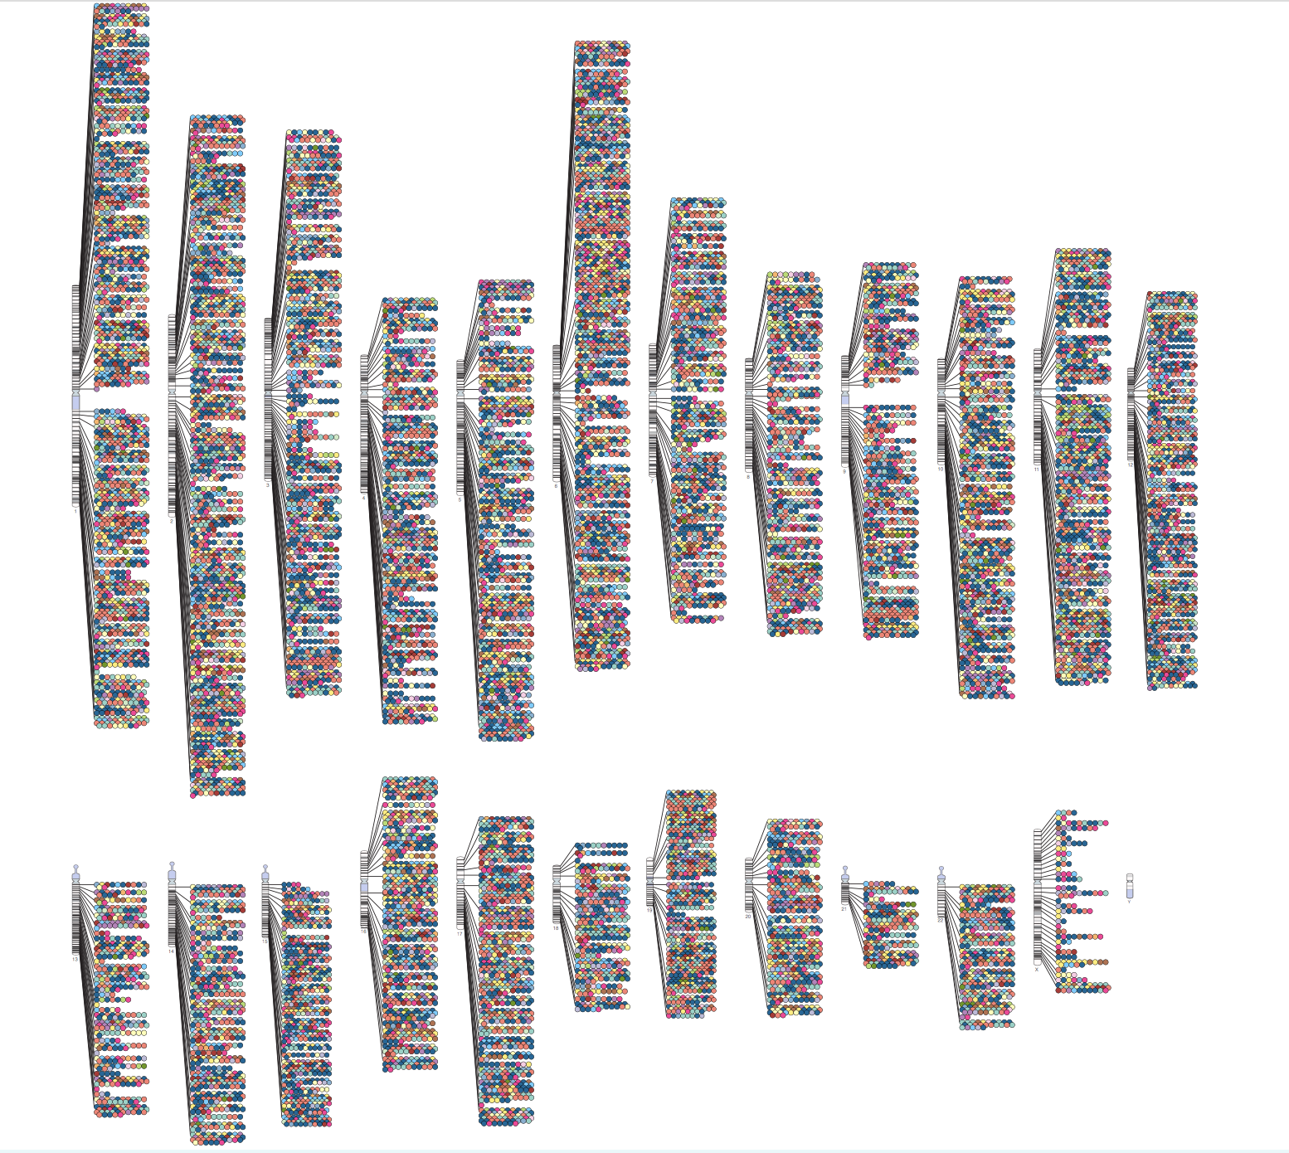
Current Stage of Complex Disease Genetics
Thousands of risk-altering genetic variants identified with Genome-wide Association analysis
Only small fraction with known biological effect
Most of this information not used in clinical practice
How to translate complex disease genetics into clinically relevant form?
https://www.ebi.ac.uk/gwas/diagram

Slide 33
Outline
Background for complex diseases
Genome-wide association analyses
Coronary heart disease prediction
Challenges in genetic prediction
Where to go from here?

Slide 34
Coronary Heart Disease Prediction
Clinical practice uses Framingham risk score
Sex specific calculator for 10-year coronary heart disease risk
Takes into account
    Age
    Total cholesterol
    Smoking
    HDL cholesterol
    Systolic blood pressure
Peter W. F. Wilson et al. (1998): Prediction of Coronary Heart Disease Using Risk Factor Categories, Circulation
  https://www.ahajournals.org/doi/full/10.1161/01.cir.97.18.1837

Slide 35
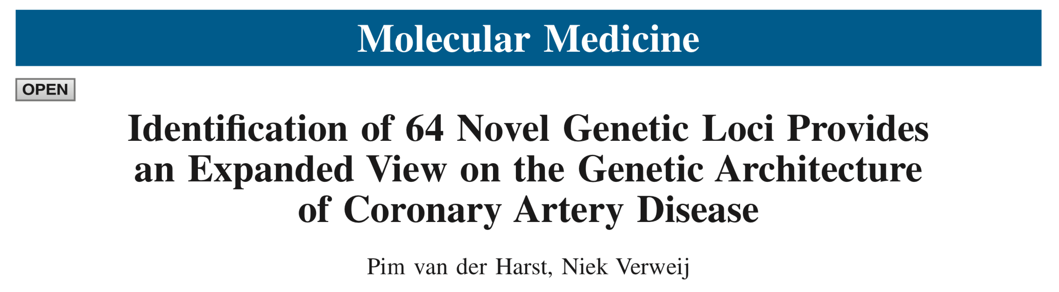
Coronary Heart Disease Genetics
Contribution of genetics estimated to be 50-60%
Over 160 genetic variants identified by the end of 2018
  Largest published study with 123k CHD cases and 425k controls
    https://www.ncbi.nlm.nih.gov/pmc/articles/PMC5805277
Most of the identified genetic variants also associated with cholesterol levels or other relevant risk factors
Genetics are currently not used in clinical practice
How could genetic information be included in the prediction models?

Slide 36
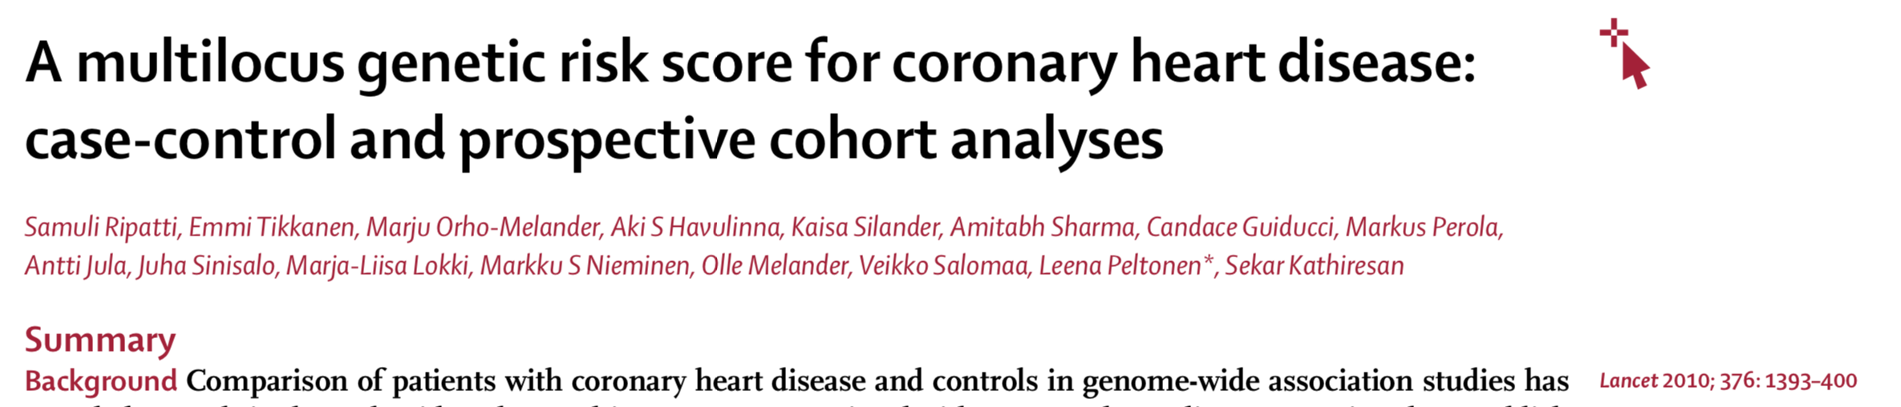
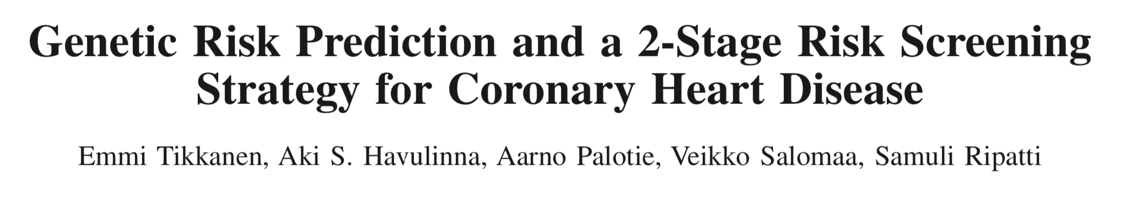
Coronary Heart Disease Prediction with Genetics
First publications combining both environmental and genetic factors published early 2010’s

Slide 37
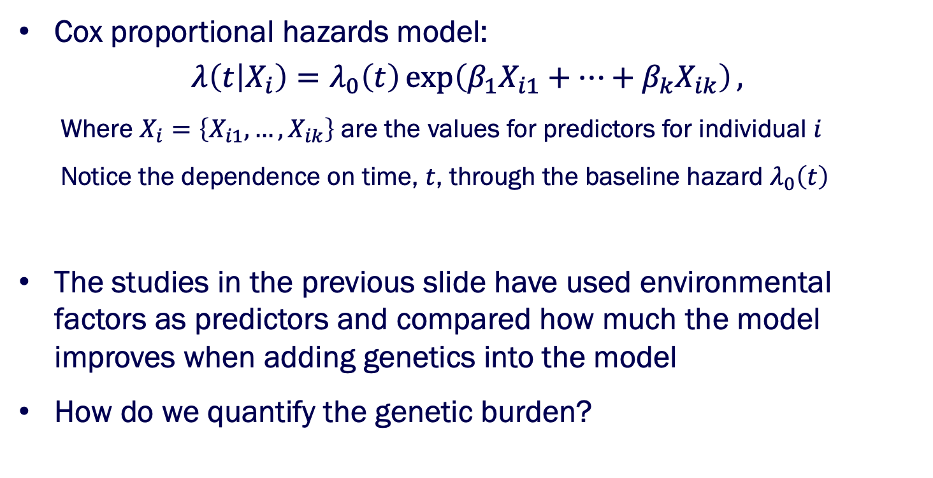
Prediction Model
Cox proportional hazards model:
$$λ\left(t | X_{i}\right)=λ_{0}\left(t\right)\exp\left(β_{1}X_{i1}+…+β_{k}X_{ik}\right),$$
  Where $X_{i}=\left\{X_{i1},…,X_{ik}\right\}$ are the values for predictors for individual $i$
  Notice the dependence on time, $t$, through the baseline hazard $λ_{0}\left(t\right)$
The studies in the previous slide have used environmental factors as predictors and compared how much the model improves when adding genetics into the model
How do we quantify the genetic burden?

Slide 38
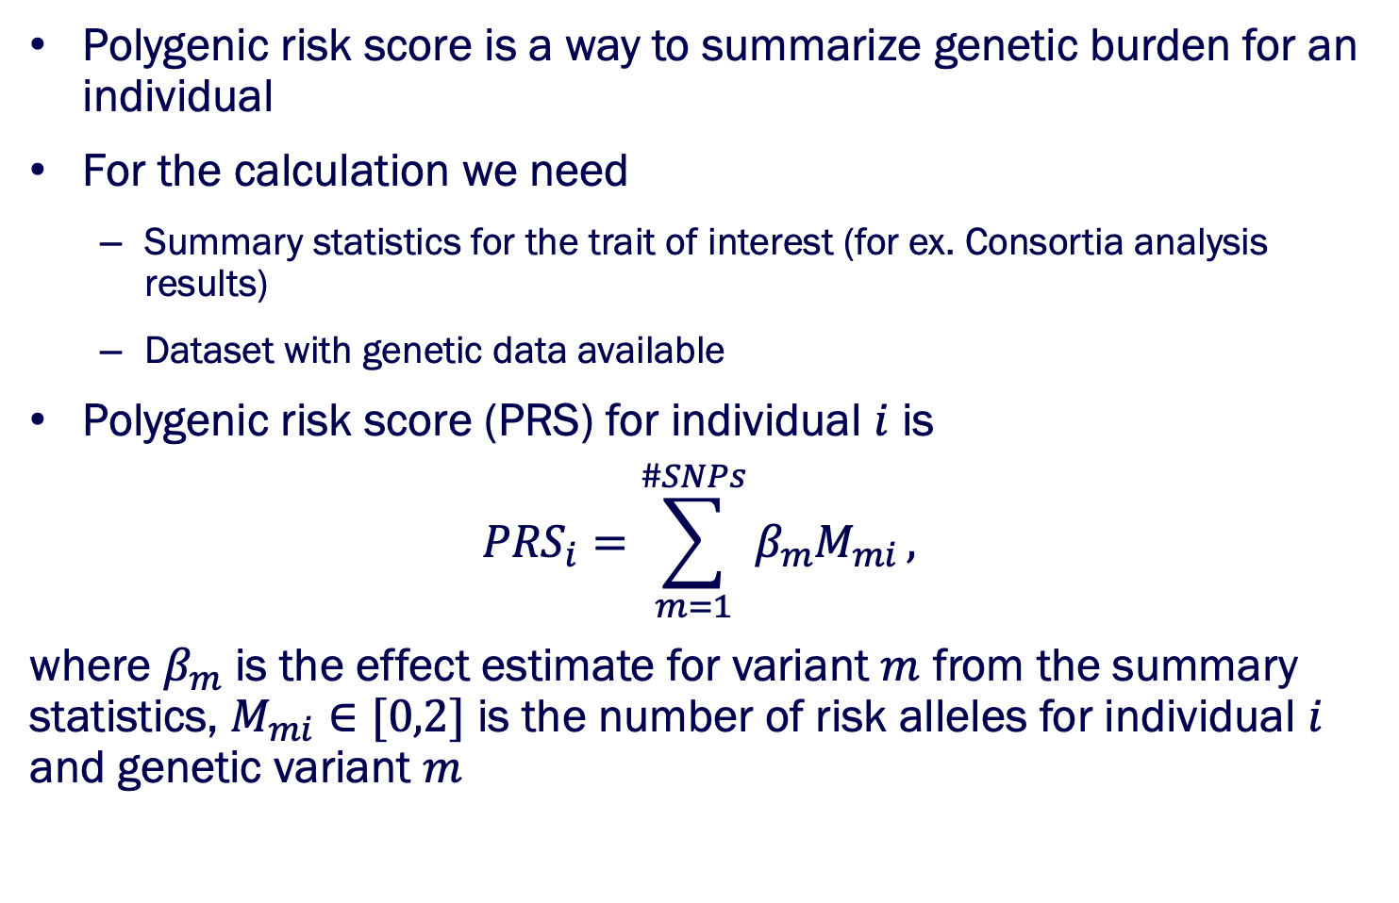
Polygenic Risk Score
Polygenic risk score is a way to summarize genetic burden for an individual
For the calculation we need
  Summary statistics for the trait of interest (for ex. Consortia analysis results)
  Dataset with genetic data available
Polygenic risk score (PRS) for individual $i$ is
$${PRS}_{i}=\sum_{m=1}^{\#SNPs}{β_{m}M_{mi}},$$
where $β_{m}$ is the effect estimate for variant $m$ from the summary statistics, $M_{mi}∈[0,2]$ is the number of risk alleles for individual $i$ and genetic variant $m$

Slide 39
Polygenic Risk Score
First polygenic risk scores only used genome-wide significant SNPs in the prediction
Current state of the art PRSs include the whole genome information
The information for the whole genome achieved by selecting all independent SNPs with effect on the trait/disease of interest
Largest scores are using information on millions of SNPs at the same time -> very computationally heavy to calculate!!
The PRS approaches normal distribution with large number of SNPs

Slide 40
Polygenic Risk Score for CHD
Prevalence of CHD in PRS percentiles
PRS Percentile
Number of samples ~70,000
Number of SNPs in the score 6.6M

Slide 41
Polygenic Risk Score for CHD
Prevalence of CHD in PRS percentiles
3-fold difference!
PRS Percentile
Number of samples ~70,000
Number of SNPs in the score 6.6M

Slide 42
Polygenic Risk Score for CHD
Dataset: HUNT
Genetic Risk Score for CAD
Controls
CHD Cases

Slide 43
Polygenic Risk Score for CHD
Dataset: HUNT
Genetic Risk Score for CAD
Controls
CHD Cases
Notice the difference between young and old?

Slide 44
Polygenic Risk Score for CHD
Dataset: HUNT
Genetic Risk Score for CAD
Controls
CHD Cases

Slide 45
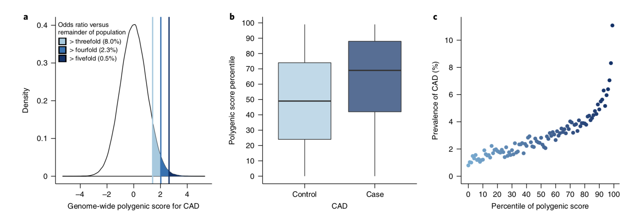
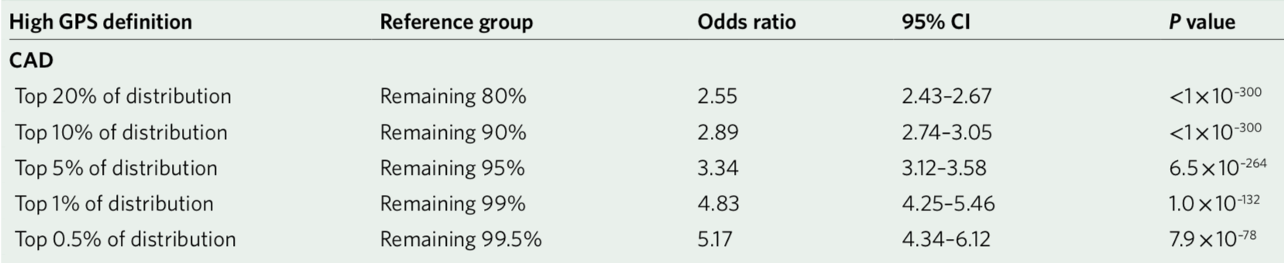
Polygenic Risk Score for CHD
Khera AV. et al (2018): Genome-wide polygenic scores for common diseases identify individuals with risk equivalent to monogenic mutations. Nature Genetics 50: 1219-1224

Slide 46
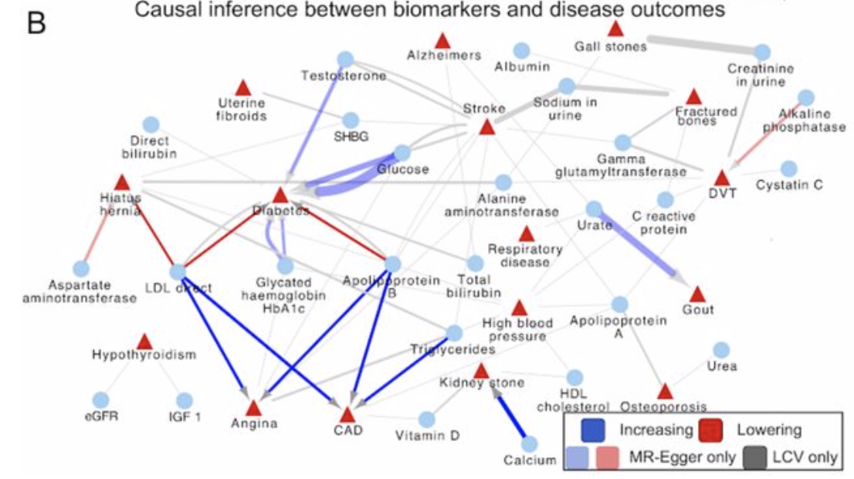
Polygenic Risk Scores for Risk Factors
Sinnot-Armstrong N. et al. (2019): Genetics of 38 blood and urine biomarkers in the UK Biobank. Bioarchives. doi: https://doi.org/10.1101/660506

Slide 47
Polygenic Risk Scores for Risk Factors
Sinnot-Armstrong N. et al. (2019): Genetics of 38 blood and urine biomarkers in the UK Biobank. Bioarchives. doi: https://doi.org/10.1101/660506

Slide 48
Outline
Background for complex diseases
Genome-wide association analyses
Coronary heart disease prediction
Challenges in genetic prediction
Where to go from here?

Slide 49
Translating Polygenic Risk into Clinics Requires …
More accurate prediction models
Good population reference datasets
  for ex. FinnGen & Ukbb & MVP BioBanks
Easy user interface for the clinicians and patients
Training for Clinicians for understanding genetic risk
  Education of future MDs in collaboration with Medical Faculty
Identifying the preventative actions that can be used to counter the risk
automated computation for the risk prediction

Slide 50
Challenges
Population differences:
  Currently association summary statistics mainly for European ancestry populations
  Applying SNP weights from different populations cause bias
  Applying risk factor weights from different populations also cause bias
Monogenic vs polygenic
  Both genetic modes should be included in the prediction
Prediction accuracy still very low
  As complex diseases are complex there is still a lot of components we don’t know, or don’t understand, mediating the risk

Slide 51
Outline
Background for complex diseases
Genome-wide association analyses
Coronary heart disease prediction
Challenges in genetic prediction
Where to go from here?

Slide 52
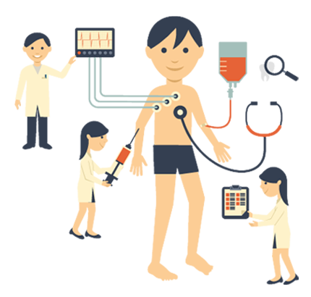






My Long Term Dream
Health checkup & blood test
Automated computing
Multi-ethnic reference database
Genotyping, omics, biomarkers, questionnaire, EHR-data
Risk report interface
Personalized risks
Personalized prevention strategies
Personalized prevention
Medical counseling

Slide 53
Personalized Prevention
If we take genetic prediction to clinical practice we need to have understanding on how to prevent disease
We cannot affect the genetic risk, only lifestyle or medication of the patient
Could biomarker risk scores be the answer to find the most suitable preventative action for an individual?
At which age should we screen for the individuals with high risk to have highest impact on the population health?
Ethical questions?

Slide 54
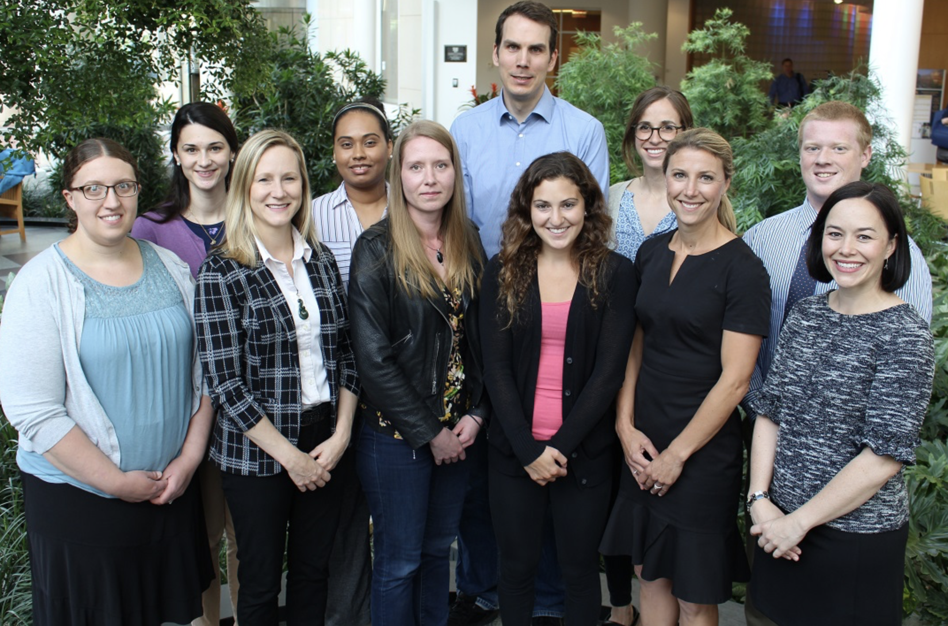


Acknowledgements
Sheunggeun (Shawn)
Lee
Cristen Willer

