Slide 1
Big Data Summer Institute Linear Algebra Review
June 23, 2022; 1:30-2:45 pm
Rupam Bhattacharyya

Slide 2
Housekeeping Information
Instructor:
Rupam Bhattacharyya
PhD Candidate, Biostatistics, University of Michigan
rupamb@umich.edu
Useful Materials:
Listed throughout the slides.
Some additional slides at the end.
Acknowledgements
Lap Sum Chan, Holly Hartman.
YT and Google.

Slide 3
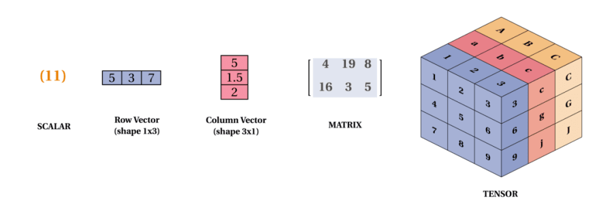
Dimensions of Objects
https://dev.to/mmithrakumar/scalars-vectors-matrices-and-tensors-with-tensorflow-2-0-1f66

Slide 4
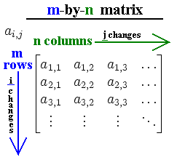
The Matrix Notation
https://upload.wikimedia.org/wikipedia/commons/8/84/Matrix.png

Slide 5
Shapes
$$m<n$$
$$m>n$$
$$m=n$$
Rectangular/Non-square
Square

Slide 6
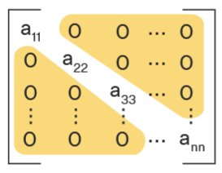
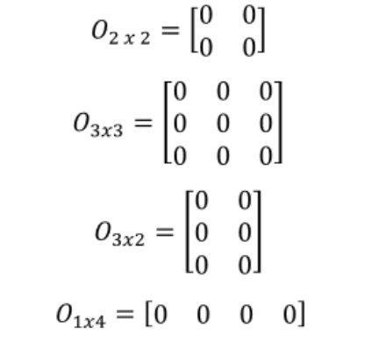
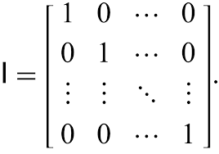
Special Matrices
Diagonal matrices.
Restricted to square matrices for us.
Identity matrices.
What are identity matrices of dimensions 1, 2, …?
Zero matrices.
Not restricted to any shape.

Slide 7
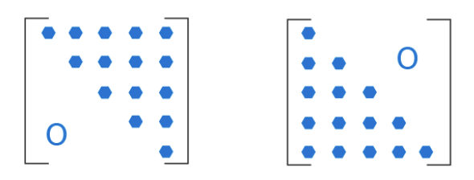
Special Matrices [Contd.]
Upper triangular.
$a_{ij}=0 if i>j$.
Lower triangular.
$a_{ij}=0 if i<j$.

Slide 8
Matrix Operations: Addition
Basically element-wise addition.
Which means if you want to add two matrices, they must have the same number of rows and same number of columns.
Impossible.
Possible.
Commutative: $A+B=B+A$.
Associative: $\left(A+B\right)+C=A+(B+C)$.

Slide 9
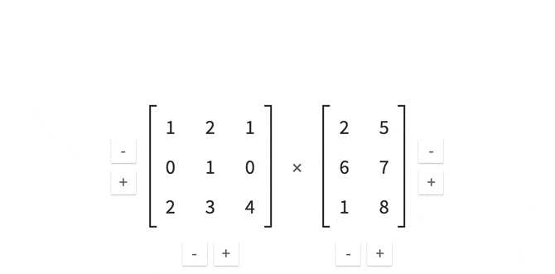
Matrix Operations: Multiplication
https://gfycat.com/positiveexhaustedamericangoldfinch

Slide 10
Multiplication [Contd.]
Not element-wise anymore.
Number of columns of the first matrix must be same as number of rows of the second.
Associative: $\left(AB\right)C=A(BC)$.
Distributive: $A\left(B+C\right)D=ABD+ACD$.
NOT commutative: $AB≠BA$.
Both may not even exist. Example?
Even if they do, may have different dimensions.

Slide 11
Other Products
Hadamard product: like addition in many ways.
Kronecker product: block-wise operation.

Slide 12
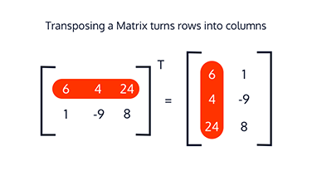
Matrix Operations: Transpose
https://www.codecademy.com/learn/learn-linear-algebra/modules/math-ds-linear-algebra/cheatsheet
Pretty obvious that this will be well-behaved with element-wise operations.
${\left(A+B\right)}^{T}=A^{T}+B^{T}$.
The procedure undoes itself, i.e., $A^{T^{T}}=A$.
Multiplication? ${\left(AB\right)}^{T}=B^{T}A^{T}$.

Slide 13
Size of a Matrix
Target: Establish rules similar to scalar numbers in the matrix world.
So far, we have been able to achieve addition (thus subtraction) and some version of multiplication.
To bring in division, we need some idea of size – since division is essentially estimating size in the scalar world.
10/2 = 5 because in our very natural sense of size, 10 is 5 times the value of 2.
3/9 < 1 because 3 is smaller in size than 9.
Need to define some size function that can take a [square] matrix as an input and compute a scalar number as output.

Slide 14
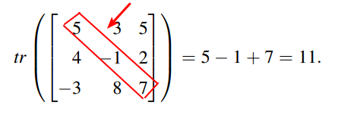
Size Function: Trace
Easy to see that this works in a linear fashion.
$tr\left(A^{T}\right)=tr(A)$.
$tr\left(A+B\right)=tr\left(A\right)+tr(B)$.
What about multiplication?
$tr\left(AB\right)=tr(BA)$.
Not enough!

Slide 15
Determinant
https://www.chilimath.com/lessons/advanced-algebra/determinant-2x2-matrix/
There is a general definition for higher dimension square matrices that we will skip here.
https://www.chilimath.com/lessons/advanced-algebra/determinant-3x3-matrix/

Slide 16
To Division and Inverses
In the scalar world, division is basically a multiplication, just like subtraction is basically an addition.
$\frac{4}{2}=4×\frac{1}{2}$.
As long as we can define $B^{−1}$ from $B$, we can go on to compute things like $B^{−1}A, AB^{−1}$ and so on.
As you would expect, determinant is connected to this.
Just like you can’t invert zero among scalars, you can’t invert matrices with determinant zero.

Slide 17
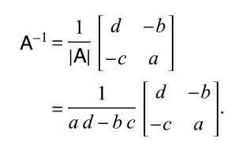
Matrix Inversion
Can be extended to higher order exactly like determinant.
Properties?
$AA^{−1}=A^{−1}A=I$.
${\left(AB\right)}^{−1}=B^{−1}A^{−1}$.
${\left(A^{−1}\right)}^{T}={\left(A^{T}\right)}^{−1}$.
$\det\left(AB\right)=\det\left(A\right)\det\left(B\right),\det\left(A^{−1}\right)=\frac{1}{det⁡(A)}$.

Slide 18
Extras
Eigenvalues and eigenvectors.
Rank of a matrix + connections with det and inverse.
Projection matrices and linear regression.
Matrices in R.

